Slide 1
Digital Government: 1. OECD policy recommendation 2. Role of social media
Arthur Mickoleit,
OECD (Directorate for Public Governance and Territorial Development)
CESI-Europe Academy “Generation Web 2.0: Using New Technologies in the Public Sector in Europe”
26-27 June 2014, Tallinn, Estonia

Slide 2
OECD Recommendation on Digital Government Strategies
Engagement, openness & trust
Leadership, coordination & governance
Implementation, capacities and legal frameworks

Slide 3
OECD Recommendation .. 1st pillar
Engagement, openness & trust
Adopt open and inclusive processes
Address digital divides and digital exclusion
Collaboration within the public sector and with external actors
Stimulate re-use of evidence, data and statistics
Balance timeliness and trustworthiness of public sector data
Include digital security in organisational and management thinking
Manage privacy risks to raise confidence in digital government services

Slide 4
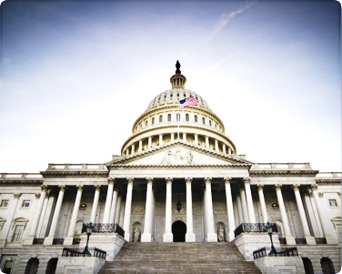
What role for social media in opening up public sector institutions?

Slide 5
Communications? Better left to personalities as they are more popular
National government leaders
National government
institutions
Notes:
Top: 20:1 for Obama vs WhiteHouse
Bottom: 5:1 for Leaders vs Institutions (sample of top 10, top 25 and top 100 national government leaders and institutions worldwide)

Slide 6
Realise service delivery opportunities: blurring the lines between competitors and partners for public service delivery
Commercial employment services
Public employment services

Slide 7
Realise trust-building opportunities: mission-critical success supported by long-term community building
14 Jan 2014: campaign
15 Jan 2014: arrest

Slide 8
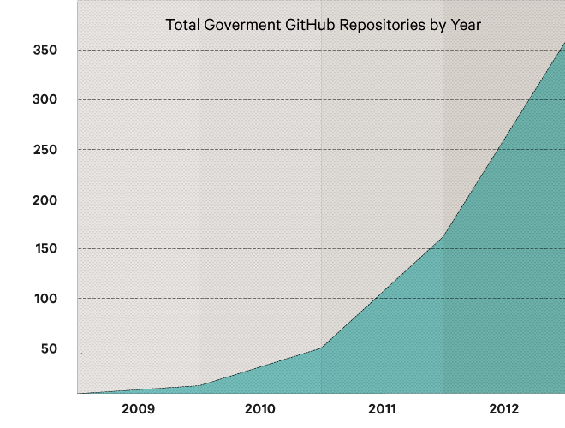
Realise IT transformation opportunities: open source, collaborative and agile development
beta.govt.nz
Notes:
Social, collaborative, agile and iterative development. Based on open source, improved through permanent testing and discarding.
Also CMS like Drupal are getting high attention from government departments all over.

Slide 9
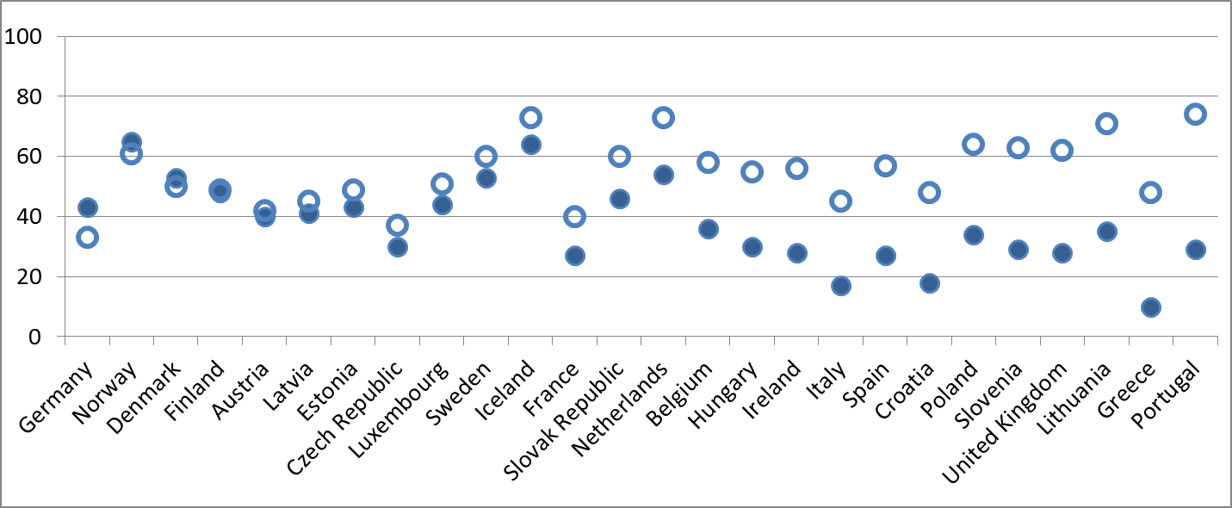
Beware of stereotypes (I)
Not a given that social media give a voice to all, including marginalised parts of the population.
74% of Portuguese with high education level use social media,
…but only
29%
of those that have
no or low education.

Slide 10
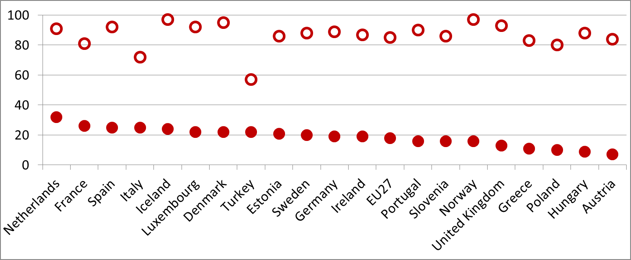
Beware of stereotypes (II)
Not a given that social media will make public matters and services appeal to young people.
80% of young Poles use social
media,
…but only 10%
to discuss political or civic issues
Notes:
And some of these countries have a couple of other problems getting young people interested in politics: UK is a country with high young voter abstention – over 1/3 of young people did not vote over past three years despite being eligible (Eurobarometer, 2013)

Slide 11
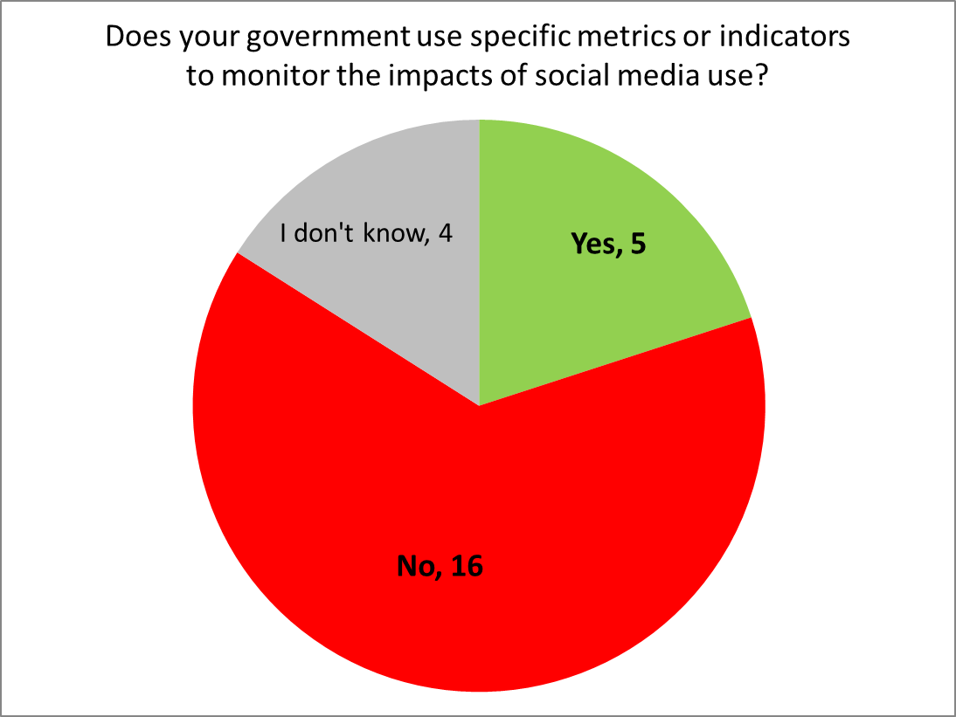
Manage the change (I)
Measurement and impact assessment is necessary, but still uncommon.
Source: OECD survey of government use of social media, 2013.
Respondents: 25 central government institutions with responsibility for digital government strategies, e.g. CIO office.

Slide 12
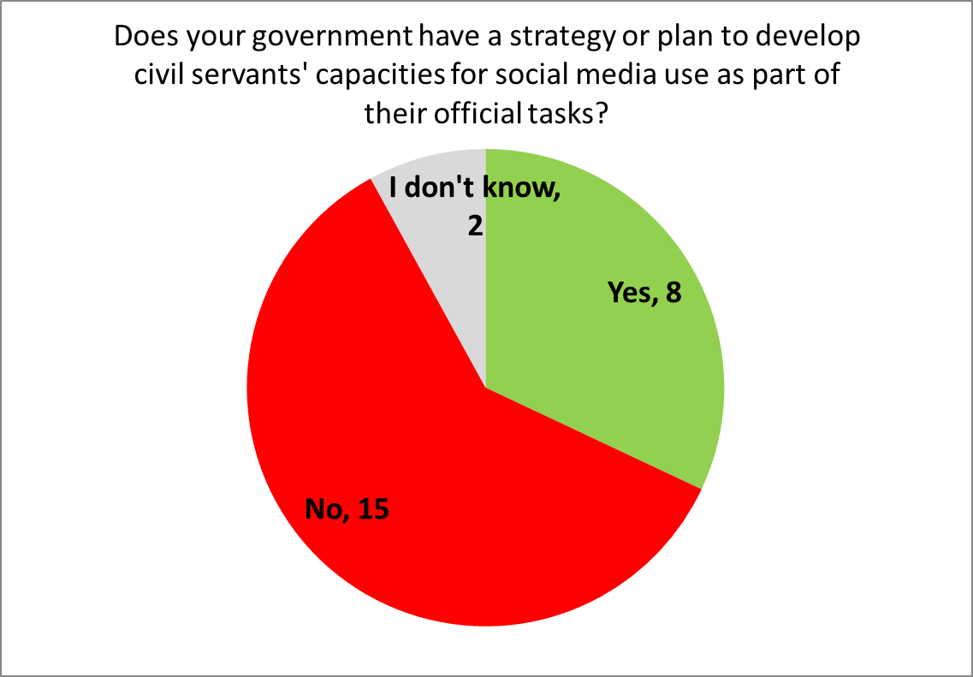
Manage the change (II)
How to prepare civil servants for a social media-rich environment?
Source: OECD survey of government use of social media, 2013.
Respondents: 25 central government institutions with responsibility for digital government strategies, e.g. CIO office.

Slide 13
Your feedback welcome
OECD social media guidance for policy-makers on:
Objectives and expectations
Governance modes and guidelines
Legal compliance
Skills and resources
Collaboration and community-building
Managing risks
Monitoring and measuring impacts
Arthur Mickoleit, OECD
arthur.mickoleit@oecd.org / @OECDgov / http://oe.cd/eldrs
Notes:
Reference to preliminary checklist in paper.

